Slide 1

INFRASTRUCTURE SOLUTIONS OF CLOUD
Module Number: 02
Module Name: Azure Networking

Slide 2
Syllabus:
Azure Networking
Creating and configuring a virtual network, Deploying a virtual machine in a virtual network, Deploying a web service in a virtual network, Modifying a network configuration
Configuring access control list, Configuring reserved IP addresses, Configuring public IP addresses, Implementing a point-to-site VPN, Implementing a site-to-site VPN, Implementing a virtual network to virtual network VPN, Configuring internal load balancing.

Slide 3
Syllabus:
Azure Networking
Configuring reserved IP addresses, Configuring public IP addresses, Implementing a point-to-site VPN, Implementing a site-to-site VPN, Implementing a virtual network to virtual network VPN, Configuring internal load balancing.

Slide 4
Azure Networking
Aim:
To equip the students to Design Virtual Network in Azure Platform.

Slide 5
Azure Networking
Objectives:
The Objectives of this module are:
Differentiate the various virtual network parameters
Deploy Virtual private Network on Azure Platform.
Modify a network configuration in Virtual private Cloud
Implement a point-to-site VPN in Azure Platform

Slide 6
Azure Networking
Outcomes:
At the end of this module, you are expected to:
Compare the various virtual network parameters
Design Virtual private Network on Azure Platform
Apply the control list in Virtual private Cloud
Create appropriate point-to-site VPN in Azure Platform.

Slide 7
Table of Contents
Azure Networking
Creating and configuring a virtual network
Deploying a virtual machine in a virtual network
Deploying a web service in a virtual network
Modifying a network configuration
Configuring access control list
Configuring reserved IP addresses
Configuring public IP addresses
Implementing a point-to-site VPN
Implementing a site-to-site VPN
Implementing a virtual network to virtual network
Configuring internal load balancing.

Slide 8
Azure Networking
Creating and configuring a virtual network
For both internal and external network connection, Azure virtual machines use Azure networking.
How to install two virtual machines and set up their Azure networking.
Although an application isn't installed in the lesson, the examples in it assume that the VMs are hosting web applications with database back ends.

Slide 9
Azure Networking
Creating and configuring a virtual network
Steps to Configure Virtual network
Create a virtual network and subnet
Create a public IP address
Create a front-end VM
Secure network traffic
Create back-end VM

Slide 10
Azure Networking
Creating and configuring a virtual network
VM networking overview
Secure network connections may be made between virtual machines, the internet, and other Azure services like Azure SQL Database thanks to Azure virtual networks.
Subnets are logical units used to divide up virtual networks. Subnets are used as a security boundary and to manage network flow.
In most cases, a virtual network interface that is connected to a subnet is included when deploying a VM.

Slide 11
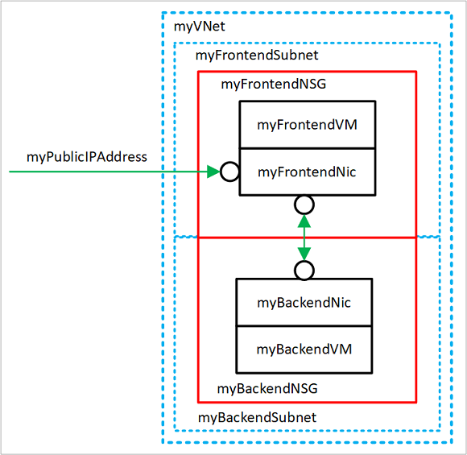
Azure Networking
Creating and configuring a virtual network
Source: https://docs.microsoft.com/en-us/azure/virtual-machines/windows/tutorial-virtual-network

Slide 12
Azure Networking
Creating and configuring a virtual network
Create virtual network
Create a VNET named myVNet using myFrontendSubnet and myBackendSubnet using New-AzVirtualNetwork:
$vnet = New-AzVirtualNetwork `
-ResourceGroupName myRGNetwork `
-Location EastUS `
-Name myVNet `
-AddressPrefix 10.0.0.0/16 `
-Subnet $frontendSubnet, $backendSubnet

Slide 13
Azure Networking
Deploying a virtual machine in a virtual network
In the same virtual network, virtual computers can be established and connected to one another using private IP addresses.
Even if they are in different subnets, virtual machines can still connect. They can connect without using public IP addresses or configuring a gateway.
A virtual network must first be created before VMs can be added to it.

Slide 14
Azure Networking
Deploying a web service in a virtual network
Each virtual machine (VM) is given a virtual network and subnet as it is being created. During deployment or startup, virtual machines get their network configurations.
When virtual machines are installed, they are given an IP address.
As they boot up, each virtual machine (VM) that you deploy into a virtual network or subnet receives an IP address. A VM may also be given a static IP address.

Slide 15
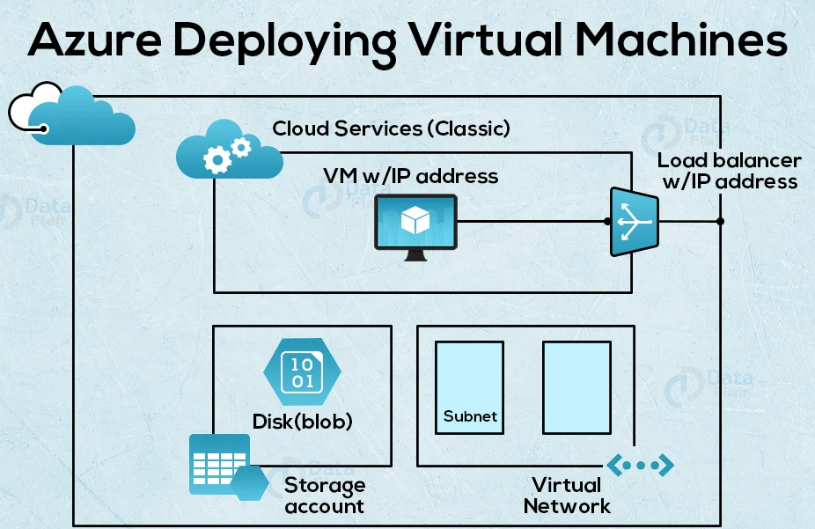
Azure Networking
Deploying a virtual machine in a virtual network
Source: https://data-flair.training/blogs/deploying-virtual-machines-in-azure/

Slide 16
Azure Networking
Deploying a virtual machine in a virtual network
A VM server is simple to create and set up, which contributes to its growing popularity.
The primary factor restricting the amount of virtual machines you can set up on one piece of hardware is the hard drive capacity, thus setting up virtual host machines is the first step.
Because each VM requires RAM and CPU, the capacity of your actual host system is important for setting up virtual server machines and for determining how many you can construct.
Make sure you have a CPU with as many cores as feasible and lots of hard drive space. Today, servers are all about multicore, so they should have the power to host your VMs.

Slide 17
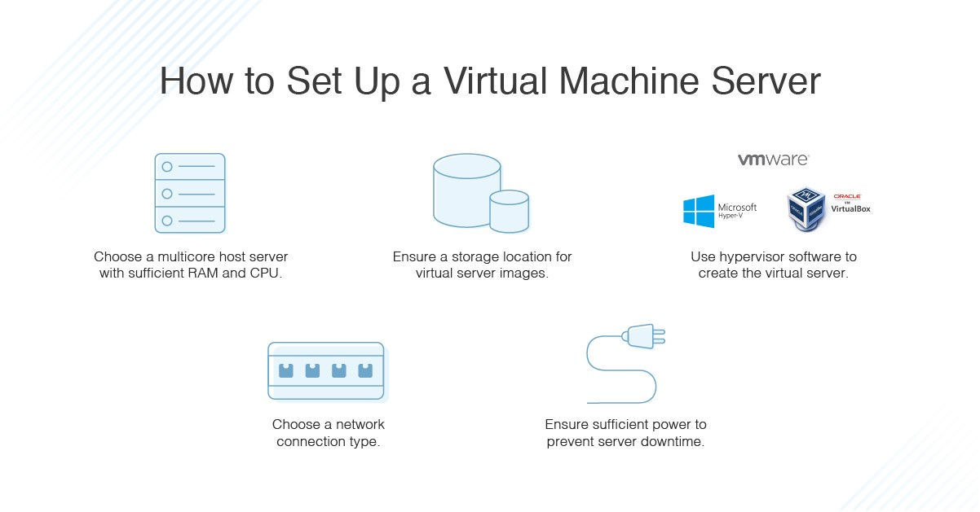
Azure Networking
Deploying a virtual machine in a virtual network
Source: https://www.dnsstuff.com/how-to-set-up-and-configure-virtual-machine-server

Slide 18
Azure Networking
Modifying a network configuration
How to create, modify, and get rid of a network interface. An Azure Virtual Machine may communicate with resources on-premises, in Azure, and over the internet thanks to a network interface.
The Azure portal automatically establishes one network interface with default settings for you when you create a virtual machine using the portal.
A virtual machine can instead have one or more network interfaces added to it when it is created, or you can construct network interfaces with specific parameters.
For an established network interface, you might also want to modify the default settings.

Slide 19
Azure Networking
Modifying a network configuration
Establish a network interface
The Azure portal automatically generates a network interface with default settings when you create a virtual machine using the portal.
You can build a network interface with specific parameters and attach it to a virtual machine while constructing the virtual machine if you prefer to define all of your network interface settings (using PowerShell or the Azure CLI).
Additionally, a network interface can be made and added to an already-existing virtual machine (using PowerShell or the Azure CLI).

Slide 20
Azure Networking
Modifying a network configuration
Network interface configuration After a network interface is built, you can examine and modify the majority of its parameters.
The network interface's DNS suffix and application security group membership are not visible in the portal. You may view the DNS suffix and application security group membership using Azure CLI or PowerShell commands.
Type "network interfaces" into the box that says "Search resources" at the top of the Azure portal.
Select network interfaces from the search results when it appears. From the list, choose the network interface whose settings you want to examine or modify.

Slide 21
Azure Networking
Modifying a network configuration
Delete the unavailable NICs
After you can remote desktop to the machine, you must delete the old NICs to avoid the potential problem:
Open Device Manager.
Select View > Show hidden devices.
Select Network Adapters.
Check for the adapters named as "Microsoft Hyper-V Network Adapter".
You might see an unavailable adapter that is grayed out. Right-click the adapter and then select Uninstall.

Slide 22
Azure Networking
Configuring access control list
Role-based access control, also known as RBAC, is how Azure manages user access to resources like storage and queues.
Access to resources can be provided at the level of subscription, resource group, storage account, individual container, or queue for an Azure AD security principle, which can be a user, group, application service principle, or managed identity for Azure resources. Determine the level of access needed before granting it to a user or group.
It is best to limit resource access to only what is absolutely necessary.

Slide 23
Azure Networking
Configuring access control list
Starting with the narrowest, the levels of scope are:
An individual container: at this scope, a role assignment applies to all of the blobs in the container as well as container properties and metadata.
An individual queue: at this scope, a role assignment applies to messages in the queue as well as queue properties and metadata.

Slide 24
Azure Networking
Configuring access control list
The storage account: at this scope, a role assignment applies to all containers and their blobs or to all queues and their messages.
The resource group: at this scope, a role assignment applies to all of the containers or queues, and all of the storage accounts in the resource group.
The subscription: at this scope, a role assignment applies to all of the containers or queues, and all of the storage accounts and all the resource groups in the subscription.

Slide 25
Azure Networking
Configuring access control list
ACL Logging and Flow-based Mirroring are features that support ACLs.
The ability to reflect traffic that complies with a permit rule to a particular physical port or LAG is known as "flow-based mirroring." Similar to the redirect function, flow-based mirroring delivers a duplicate of the authorized traffic to the mirror interface while the original packet continues to be sent normally through the device.
Mirror and redirect properties cannot be set for a specific ACL rule.
ACL Logging offers a way to keep track of how many times an ACL rule has been "struck.“
When you configure ACL Logging, you add a "log" parameter that enables the collection and reporting of hardware hit counts to the ACL deny rule specification.

Slide 26
Azure Networking
Configuring reserved IP addresses
How do we reserve an IP address in Azure?
steps to set up a static public IP address.
Login to MS Azure portal.
Click “Virtual Machines” from the left menu.
Click “Add”.
Add the basic information about the virtual machine to be set up.
In the Networking tab, for Public IP click “Create new”.
Under assign, select Static.
Click OK.

Slide 27
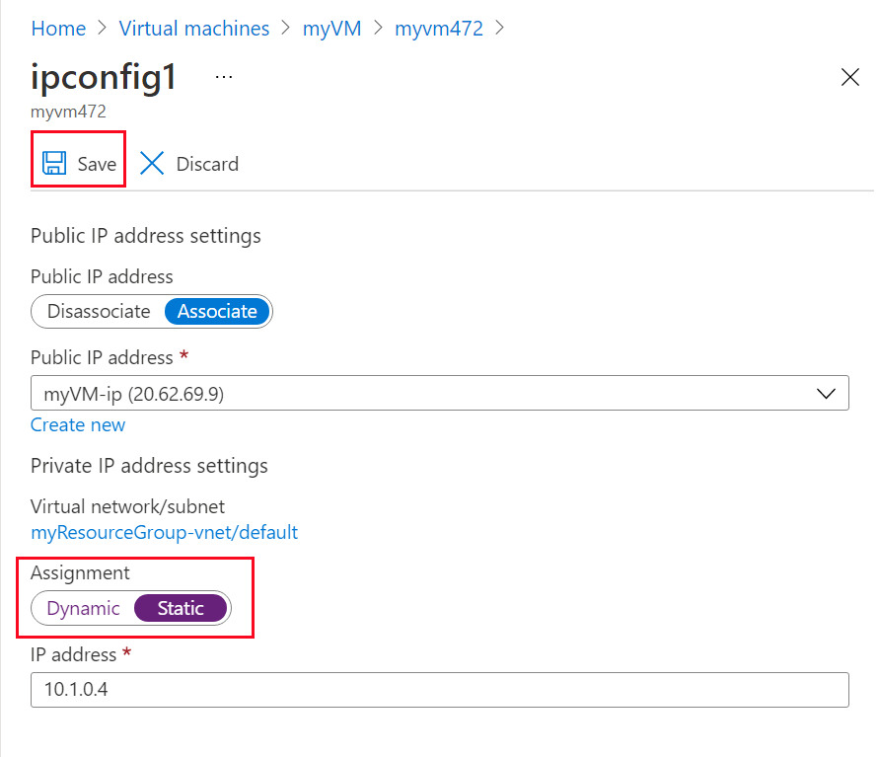
Azure Networking
Configuring reserved IP addresses
Source: https://learn.microsoft.com/en-us/azure/virtual-network/ip-services/virtual-networks-static-private-ip-arm-pportal/

Slide 28
Azure Networking
Configuring reserved IP addresses
Under Settings, click "IP Configurations".
Assign Static Public IP Address To Azure VM
Click IP configuration (e.g. ipconfig1).
Under Public IP address settings, for Public IP address click Enabled.
Click “IP address”.
Click “Create New”.

Slide 29
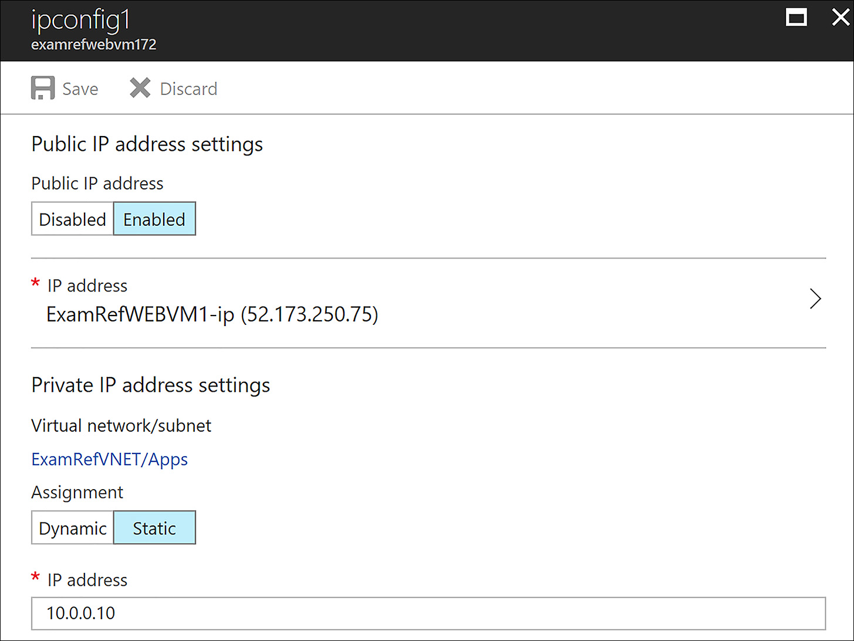
Azure Networking
Configuring public IP addresses
Under Assignment, select Static.
Assign Static Public IP Address To Azure VM
Click OK.
Click Save to save the changes to the network interface.
Source: ttps://www.microsoftpressstore.com/articles/article.aspx?p=2873369&seqNum=3

Slide 30
Azure Networking
Implementing a point-to-site VPN
How to Configure Azure Point to Site VPN?
Create a Resources Group.
Create a Virtual Network.
Create a Gateway subnet.
Create Virtual Network Gateway.
Create Root and Client Certificates.
Configure a Point-To-Site Connection.
Testing the VPN Connection.

Slide 31
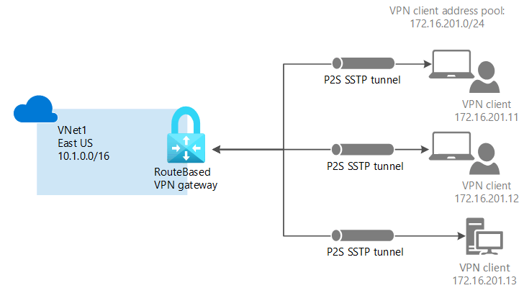
Azure Networking
Implementing a point-to-site VPN
Source: https://docs.microsoft.com/en-us/azure/vpn-gateway/vpn-gateway-howto-point-to-site-resource-manager-portal

Slide 32
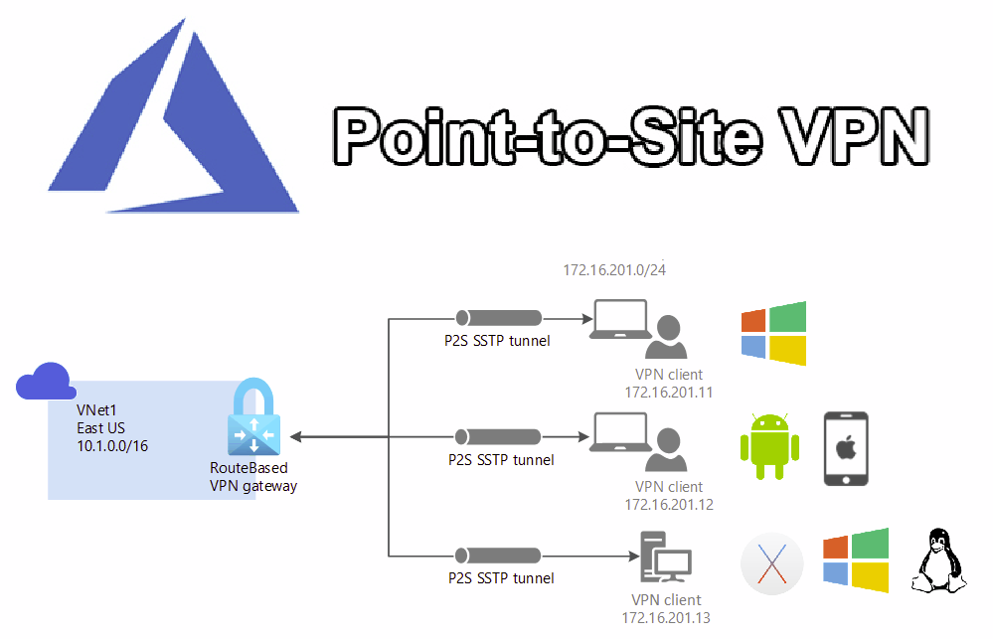
Azure Networking
Implementing a point-to-site VPN
Source: https://www.velements.net/2021/07/16/az-700-p2svpn/

Slide 33
Azure Networking
Implementing a point-to-site VPN
Create Subnets
Under the virtual network I am going to create a subnet for my servers. To create subnet use,
$vn = Get-AzureRmVirtualNetwork -ResourceGroupName REBELVPNRG -Name REBEL-VNET
Add-AzureRmVirtualNetworkSubnetConfig -Name REBEL-SVR-SUB -VirtualNetwork $vn -AddressPrefix 192.168.100.0/24
Set-AzureRmVirtualNetwork -VirtualNetwork $vn

Slide 34
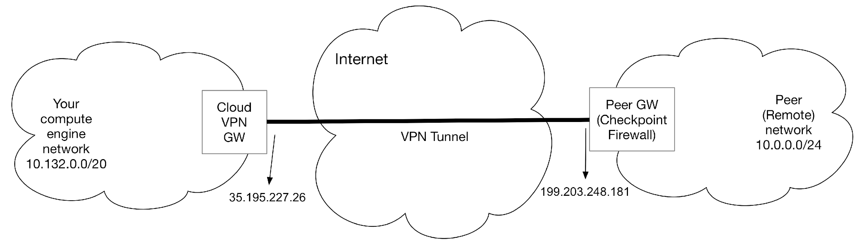
Azure Networking
Implementing a point-to-site VPN
Source:https://supportcenter.checkpoint.com/supportcenter/portal?eventSubmit_doGoviewsolutiondetails=&solutionid=sk123602

Slide 35
Azure Networking
Implementing a site-to-site VPN
To set up a Site-to-Site VPN connection using a virtual private gateway, complete the following steps:
Prerequisites
Step 1: Create a customer gateway
Step 2: Create a target gateway
Step 3: Configure routing
Step 4: Update your security group
Step 5: Create a Site-to-Site VPN connection
Step 6: Download the configuration file
Step 7: Configure the customer gateway device

Slide 36
Azure Networking
Implementing a site-to-site VPN
To use the console to create a customer gateway
Navigate to https://console.aws.amazon.com/vpc to access the Amazon VPC console.
Select Customer gateways from the navigation pane, and then click Create customer gateway.
After completing the following, select Create Customer Gateway.
Enter a name for your customer gateway in the Name tag field (optional). By doing this, you produce a tag with the key Name and the value you specify.
Enter the BGP Autonomous System Number (ASN) for your client gateway in the BGP ASN field.
Enter your client gateway device's static, internet-routable IP address in the IP address field (optional). Use the public IP address of the NAT device if your customer gateway device is situated behind one that is NAT-T configured.

Slide 37
Azure Networking
Implementing a site-to-site VPN
A Site-to-Site VPN gateway connection is linked to an Azure virtual network via an IPsec/IKE (IKEv1 or IKEv2) VPN tunnel using a site-to-site VPN gateway connection.
This kind of connection requires a VPN device that is on-site and has been given a public IP address that is visible from the outside.

Slide 38
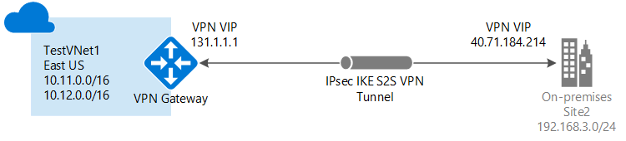
Azure Networking
Implementing a site-to-site VPN
Source: https://docs.microsoft.com/en-us/azure/vpn-gateway/vpn-gateway-howto-site-to-site-classic-portal

Slide 39
Azure Networking
Implementing a site-to-site VPN
Configure your VPN device
Site-to-Site connections to an on-premises network require a VPN device.
In this step, you configure your VPN device. When configuring your VPN device, you need the following values:
A shared key. This is the same shared key that you specify when creating your site-to-site VPN connection
The Public IP address of your virtual network gateway. You can view the public IP address by using the Azure portal, PowerShell, or CLI.

Slide 40
Azure Networking
Implementing a site-to-site VPN
Create the connection
This step is not accessible using Azure Cloud Shell or the Azure site for the conventional deployment paradigm. The local Azure PowerShell cmdlets on your PC must be the Service Management (SM) version.
You set the shared key and establish the connection in this step using the values from the preceding ones. The key you choose must match the key used to configure your VPN device.
Establish the connection after setting the shared key.
Both the -VNetName and -LocalNetworkSiteName values need be modified. Use single quote marks around the value when specifying a name with spaces.

Slide 41
Azure Networking
Implementing a virtual network to virtual network
What is VNet Peering?
We can link two Azure virtual networks together via virtual network peering. For connection reasons, the virtual networks appear as one when peered.
VNet peering comes in two flavours. Azure virtual networks in the same region are connected through regional VNet peering.
Azure virtual networks located in several locations are connected by global VNet peering.

Slide 42
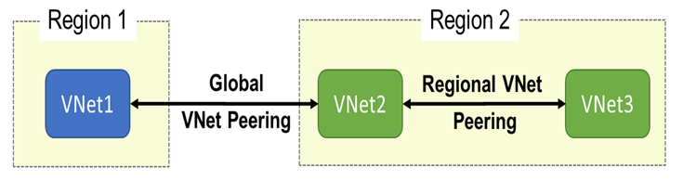
Azure Networking
Implementing a virtual network to virtual network
Source: https://rajanieshkaushikk.com/2020/03/12/how-to-setup-service-chaining-in-azure/

Slide 43
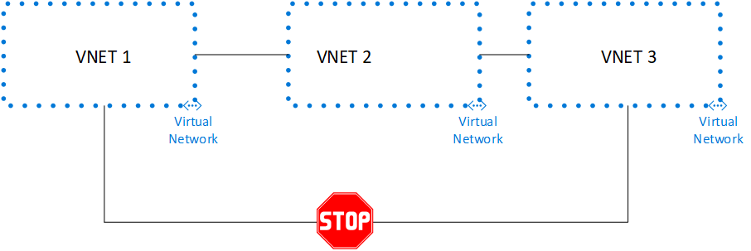
Azure Networking
Implementing a virtual network to virtual network
VNet Peering Problems: Peering on the VNet is NOTRANSITIVE.
As a result, the capabilities of VNet Peering between VNet1 and VNet3 are not applicable if VNet Peering is established between VNet1 and VNet2 and between VNet2 and VNet3. The illustration below demonstrates this:
Source: https://rajanieshkaushikk.com/2020/03/12/how-to-setup-service-chaining-in-azure/

Slide 44
Azure Networking
Implementing a virtual network to virtual network
How can the limitations of Vnet Peering be fixed?
We can set up hub-and-spoke networks, where the hub virtual network serves as the home for infrastructure elements like a VPN gateway or network virtual appliance.
The hub virtual network will subsequently be able to peer with all of the spoke virtual networks.
In the hub virtual network, traffic may pass through network virtual appliances or VPN gateways. In this manner, there are no limitations on how the networks can communicate with one another.

Slide 45
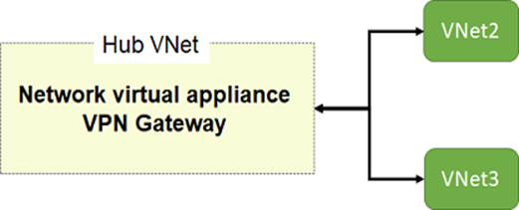
Azure Networking
Implementing a virtual network to virtual network
Source: https://rajanieshkaushikk.com/2020/03/12/how-to-setup-service-chaining-in-azure/

Slide 46
Azure Networking
Configuring internal load balancing.
Operating at layer 4 of the Open Systems Interconnection (OSI) model is Azure Load Balancer.
For customers, it serves as a single point of contact. Inbound flows are distributed to backend pool instances by the load balancer from the load balancer's front end.
These flows follow the load-balancing rules and health probes that have been set up.
Azure virtual machines or instances from a virtual machine scale set can be used as the backend pool instances.

Slide 47
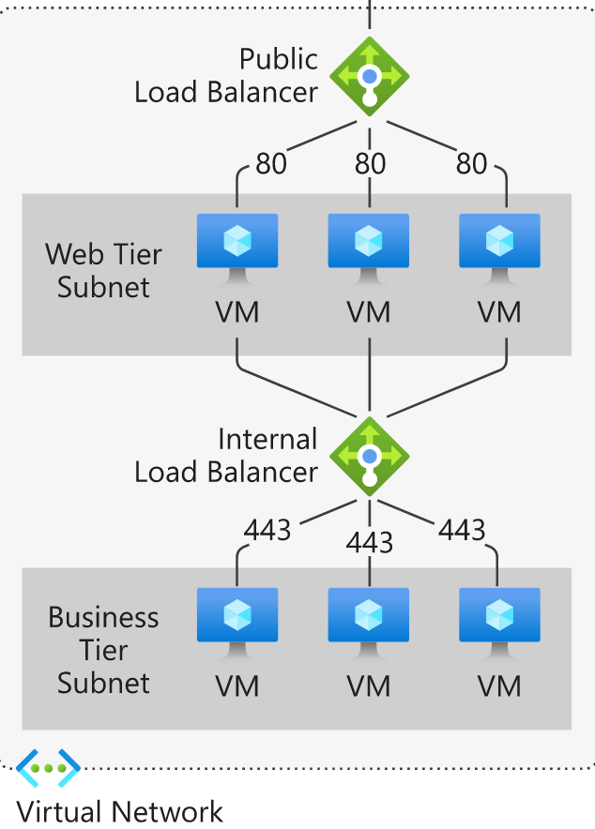
Azure Networking
Configuring internal load balancing.
Source: https://docs.microsoft.com/en-us/azure/load-balancer/load-balancer-overview

Slide 48
Azure Networking
Configuring internal load balancing.
Internal load balancer
To handle and direct client requests to various VMs that are present on the same network, an internal load balancer is employed.
A VM will experience some conjunction if the client makes a lot of queries to it. The load balancer idea, where the user requests are jointly shared between the two separate VMs set in the VNet, can be used to handle this conjunction.
Based on the configuration we set when we create a load balancer, the request will be divided among the VMs.

Slide 49
Azure Networking
Configuring internal load balancing.
Get started with Azure Load Balancer by using the Azure portal to create an internal load balancer and two virtual machines.
Prerequisites. ...
Sign in to Azure. ...
Create the virtual network.
Create load balancer.
Create NAT gateway.
Create virtual machines.
Create test virtual machine.
Install IIS.

Slide 50

Azure Networking
Summary
In this module, we have studied Azure Platform Networking , Azure VPN Gateway connects your on-premises networks to Azure through Site-to-Site VPNs in a similar way that you set up and connect to a remote branch office. The connectivity is secure and uses the industry-standard protocols Internet Protocol Security (IPsec) and Internet Key Exchange (IKE).
Point-to-Site VPN lets you connect to your virtual machines on Azure virtual networks from anywhere, whether you are on the road, working from your favorite café, managing your deployment or doing a demo for your customers.
Virtual Network Gateways are a classic approach, that many network architects are familiar with. You deploy one VPN Virtual Network Gateway Service within a Virtual Network. That service combines Point-to-Site and Site-to-Site Gateways and can be deployed in different sizes.

Slide 51
Azure Networking
Self Assessment ( Quiz)
Q1. Point out the correct statement.
a) The Windows Azure service it The Windows Azure Platform allows a developer to modify his application so it can run in the cloud on virtual machines hosted in Microsoft datacenters
b) Windows Azure serves as a cloud operating system
c) With Azure’s architecture, an application can run locally, run in the cloud, or some combination of both
d) All of the mentioned
Answer: d

Slide 52
Azure Networking
Q2. A _________ role is a virtual machine instance running the Microsoft IIS Web server that can accept and respond to HTTP or HTTPS requests.
a) Web
b) Server
c) Worker
d) Client
Answer: a

Slide 53
Azure Networking
Q3. Which of the following element in Azure stands for management service?
a) config
b) application
c) virtual machines
d) none of the mentioned
Answer: a)

Slide 54
Azure Networking
Q4. Which of the following is also known as Compute?
a) set of virtual machine instances
b) set of replicas
c) set of commodity servers
d) all of the mention
Answer: a)

Slide 55
Azure Networking
Q5. Which of the following is used to transmit structured data over network?
XML
JSON
Only 1
Both 1 and 2
Answer: d

Slide 56
Azure Networking
Q6. The technology used to distribute service requests to resources is referred to as _____________
Load Scheduling
Load Performing
Load Balancing
None
Answer: c

Slide 57
Azure Networking
Q7. When planning to migrate a public website to Azure, you must plan to pay monthly usage costs.
No change is needed
Deploy a VPN
pay to transfer all the website data to Azure
reduce the number of connections to the website
Answer- a)

Slide 58
Azure Networking
Q8. You have an on-premises network that contains 100 servers.
You need to recommend a solution that provides additional resources to your users. The solution must minimize capital and operational expenditure costs.
What should you include in the recommendation?
a complete migration to the public cloud
an additional data center
a private cloud
a hybrid cloud
Answer: c)

Slide 59
Azure Networking
Q9. Which load balancer operates at both individual request level (Layer 7) and connection level (Layer 4) only?
(a) Application Load Balancers
(b) Network Load Balancers
(c) Storage Load Balancers
(d) Classic Load Balancers
Answer: d

Slide 60
Azure Networking
10. Elastic Load Balancing offers:
(a) Ability to load balance across AWS
(b) Ability to load balance on-premises resources
(c) A and B both
(d) None of these
Answer: c

Slide 61

Azure Networking
Activity
Activity Type: Offline Duration: 60 Minutes
Description: Case Study: Creating an IPSEC secure tunnel between a Symantec Enterprise
Firewall

Slide 62

Azure Networking
Subjective Assessment
What are the Azure VPN benefits?
What are the Objective of Control List in Azure Platform?
Discuss the limitation of point to Site VPN.

Slide 63

Azure Networking
External Resources
Azure Networking Cookbook: Practical recipes for secure network infrastructure, global application delivery, and accessible connectivity in Azure, 2nd Edition
https://www.oreilly.com/library/view/azure-networking-cookbook/9781789800227/c87b98d6-b4c8-4e7a-8d0b-e712b9d0504d.xhtml

Slide 64
Azure Networking
Document Links
Topics | URL | Notes
Point to Site VPN | https://docs.oracle.com/en-us/iaas/Content/Resources/Assets/whitepapers/ipsec-vpn-best-practices.pdf | This link explain Point to Site VPN
Configure Load Balancer | https://pdfs.loadbalancer.org/v7/quickstartguideLBVMv7.6.pdf | This link explains how to Configure Load Balancer

Slide 65
Azure Networking
Video Links
Topics | URL | Notes
AZURE VPN | https://www.youtube.com/watch?v=5NMcM4zJPM4 | This video explains AZURE VPN
Site to Site VPN | https://www.youtube.com/watch?v=BaFMSV2UF_U | You will learn Site to Site VPN
Point to Site VPN | https://www.youtube.com/watch?v=-GEEv_7xrEo | This video explains Point to Site VPN

Slide 66
Azure Networking
E-Book Links
Topics | URL | Page Number
Azure Networking | · https://download.microsoft.com/download/A/9/3/A93DBAC9-E6DE-479C-A62B-A460633F84DB/MSFT_cloud_architecture_networking.pdf | All pages

